Slide 1

Sellinger Applied Portfolio
Portfolio Review | Spring 2017

Slide 2
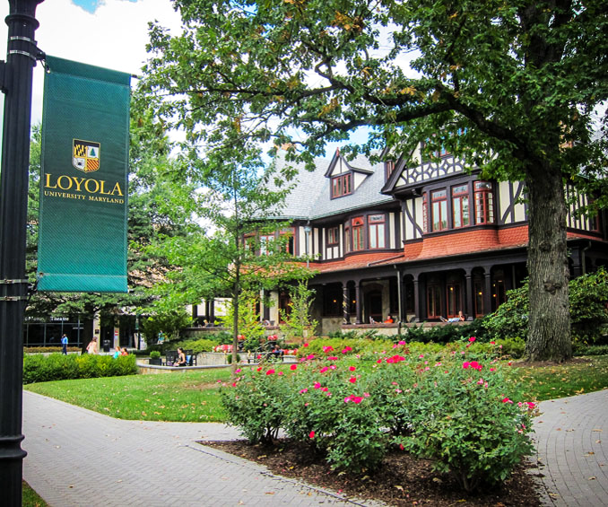
TABLE OF CONTENTS
Overview
Economic Conditions
Sector Summaries
Portfolio Strategy & Composition
  Growth
  Value
  Dividend
  ETF
Risk Analysis
Performance Review
Student Biographies

Slide 3

OVERVIEW
Spring 2017
Overview
Economic Conditions
Sector Summaries
Portfolio Strategy & Composition
Risk Analysis
Performance Review
Student Biographies

Slide 4
Sellinger Applied Portfolio Overview
Background
Process
The Student-Managed Sellinger Applied Portfolio Fund “SAP Fund” was established to provide students with actual portfolio management experience. Students are exposed to various aspects of the portfolio management process, including asset valuation, diversification, portfolio optimization, asset selection, risk management, performance evaluation, and rebalancing . Each year the University may provide the SAP Fund with up to $500,000 to invest. These funds are a component of the University’s endowment.
Loyola faculty hand selects 20 eligible students to manage the Sellinger Applied Portfolio Fund each semester. Member participation stems from team formation to analyze and pitch stock recommendations for the fund to invest in. Members in their entirety then vote on whether the recommendations pass and are implemented into the fund.

Slide 5
ECONOMIC CONDITIONS
Spring 2017
Overview
Economic Conditions
Sector Summaries
Portfolio Strategy & Composition
Risk Analysis
Performance Review
Student Biographies

Slide 6
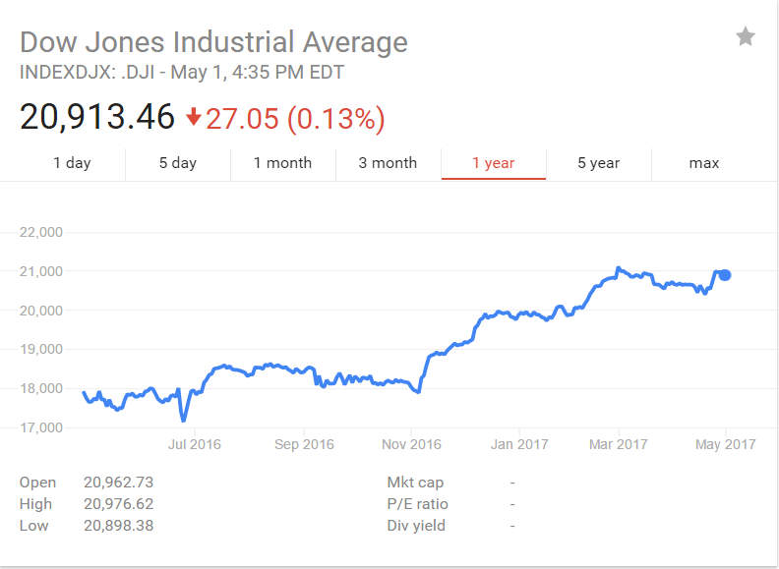

The Trump Trade
The market has been on a seemingly nonstop bull run after Donald Trump’s Election. Breaking records consistently including DOW 20k and 21k
The market has persisted its upward trend even through several controversial foreign and domestic decisions including:
  A total immigration ban for 7 primarily Muslim countries in the Middle east.
  A Syrian Missile Launch
  Dropping of the MOAB
  Protectionist policy on imports from Canada and Mexico.
Top performing sectors since Trump’s Election include: Financials (+19%), Industrials (+16%), Consumer discretionary (+15.5%), and Technology (+14.5%)
The only sector with negative returns since the election is the Energy sector (-2.21%)

Slide 7
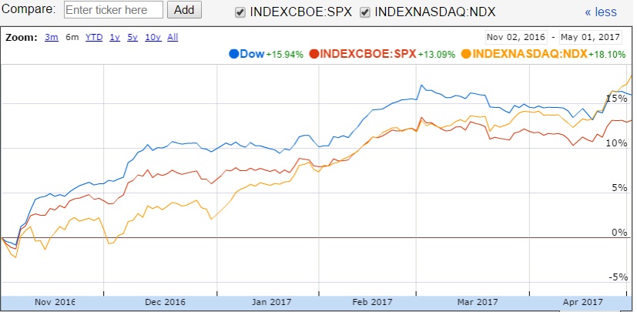
US Major Indices
6 month return
DOW JONES +15.49%
S&P 500 +13.09%
NASDAQ +18.10%
Beginning of Semester

Slide 8
U.S Trade Deficit
The goods and services deficit in the United States narrowed to 43.6 billion in February of 2017 from a downwardly revised 48.2 billion gap a month earlier
Total exports rose 0.2 percent to 192.9 billion in February, reaching a new high since December of 2014 and following a 0.8 percent gain in January.
Total imports fell 1.8 percent to USD 236.4 billion in February, reversing form a 2.3 percent rise in January.
More than 40 percent of the U.S. trade deficit in goods was with China.
  The $347 billion deficit with China was created by $462 billion in imports. It was primarily consumer electronics, clothing and machinery.
The second largest trade deficit is $69 billion with Japan.
The third largest trade deficit is with Germany at $65 billion.
Notes:
Source: https://www.thebalance.com/trade-deficit-by-county-3306264

Slide 9
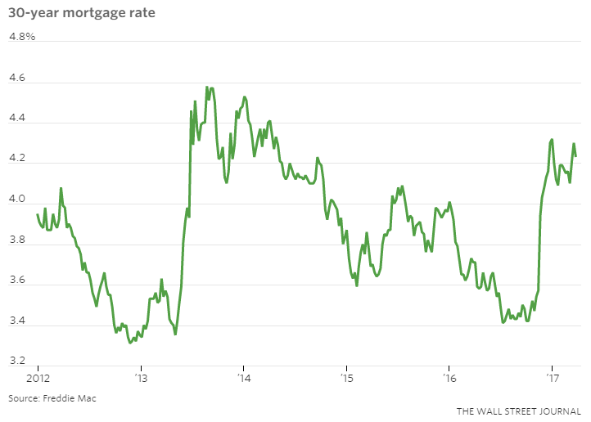
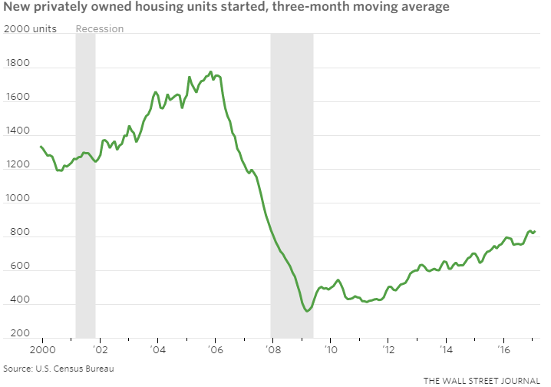
U.S Housing Market
The Commerce Department said new home sales increased 6.1 percent to a seasonally adjusted annual rate of 592,000 units last month
New U.S. single-family home sales jumped to a seven-month high in February
The 30-year fixed mortgage rate is around 4.30 percent
Notes:
Source: http://www.cnbc.com/2017/02/24/us-new-home-sales-rose-37-in-january-vs-estimate-of-63.html

Slide 10
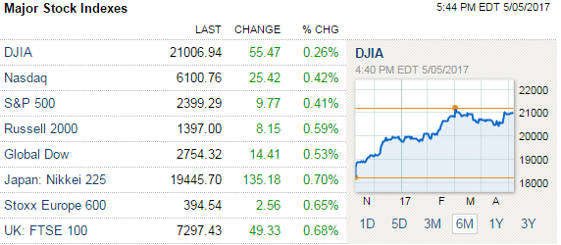
International Economics
United Kingdom plans to leave the European Union by March 29, 2019 through Article 50. UK economic growth decreased as a results of the Brexit vote.
Despite being one of the EU’s top economies, France is in an economic downturn due to high unemployment rates and minimal growth. France’s debt is 90% of the nation’s GDP, one of the largest rates in the European Union.
Germany’s economy is stagnant in 2017 following its substantial GDP increase of 1.9% in 2016.

Slide 11
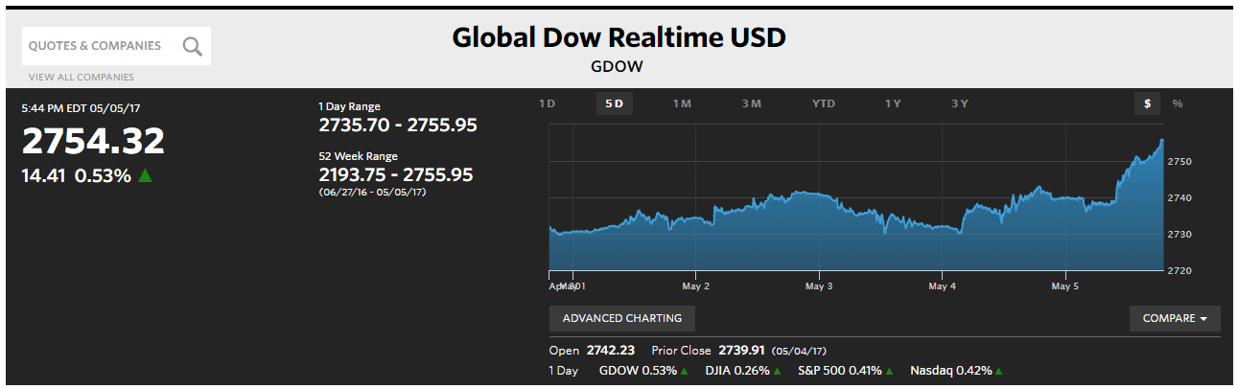
International Economics
Global Inflation fell to 3.8% in February 2017 from 3.9% in January 2017
China’s economy grew 6.9% in first quarter of 2017 despite having a large national debt
The International Monetary Fund has asked China numerous times to act on its large debt as it is a threat to the global economy
China’s current debt-to-GDP ratio is around 400%; in 2000 it was about 100%
Notes:
http://money.cnn.com/2017/04/16/news/economy/china-gdp-economic-growth/
http://www.marketwatch.com/story/chinas-economy-is-dangerously-close-to-unraveling-2017-02-18

Slide 12
SECTOR SUMMARIES
Spring 2017
Overview
Economic Conditions
Sector Summaries
Portfolio Strategy & Composition
Risk Analysis
Performance Review
Student Biographies

Slide 13
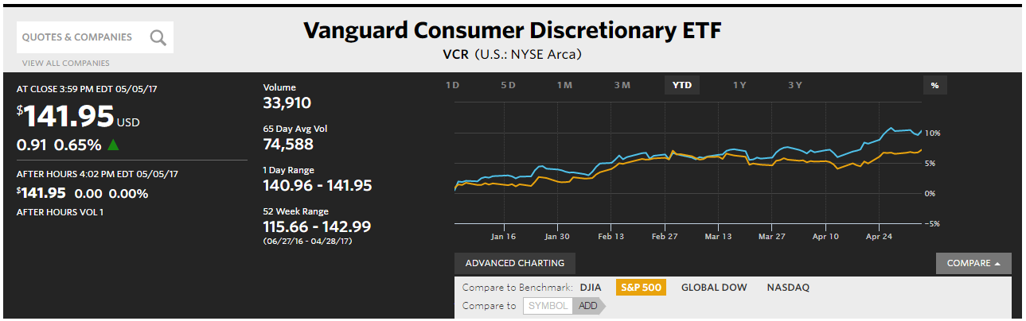
Consumer Discretionary
Performance (YTD):
10.60%
Portfolio Holdings:
Ford (F)
Michael KORS (KORS)
Comcast (CMCSA)
Walt Disney (DIS)
Stocks to Watch:
Amazon (AMZN)
The Consumer Discretionary Sector is made up of industries and companies that sell non-essential goods and services and tend to be the most sensitive to economic cycles. The manufacturing segment includes automotive, textiles, apparel, luxury goods, and leisure equipment and products. The services segment includes hotels, restaurants and leisure facilities, media production and services, and consumer retailing and service.

Slide 14
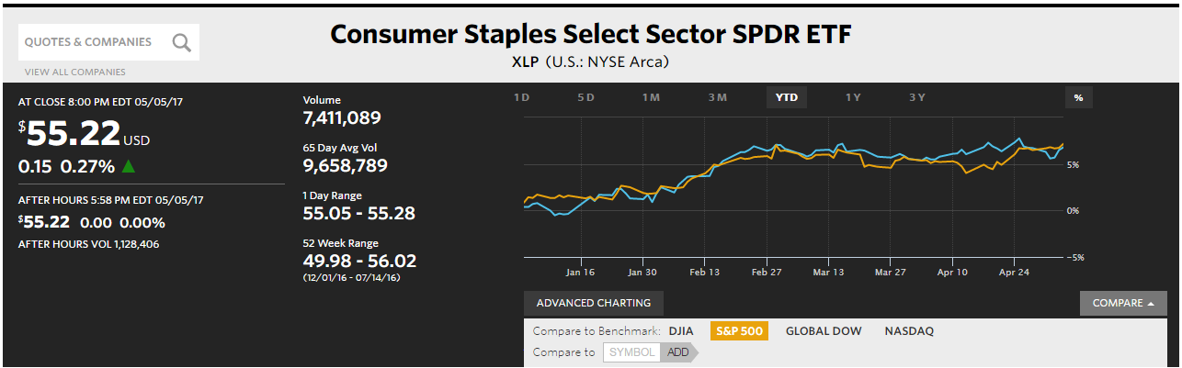
Consumer Staples
Performance (YTD):
10.91%
Portfolio Holdings:
Ford (F)
Michael KORS (KORS)
Comcast (CMCSA)
Walt Disney (DIS)
Stocks to Watch:
Walmart (WMT)
The Consumer Staples Sector consists of products that people believe are essential and products people are unwilling to take out even if their financial situation worsens. Consumer staple products are non-cyclical and therefore their performance is not dependent on how well the economy is doing. Consumer staple products are always in demand at a constant level, regardless of their price. Food, beverages, tobacco and household items make up the Consumer Staples Sector.
The Consumer Staples sector has returned 10.91% Year-to-Date and has consistently beaten the market, consisting of roughly 9.3% of the S&P 500. With a recent increase in consumer spending the sector has continued to rise however rising inflation and interest rates may lead to slower growth for companies within the sector.

Slide 15
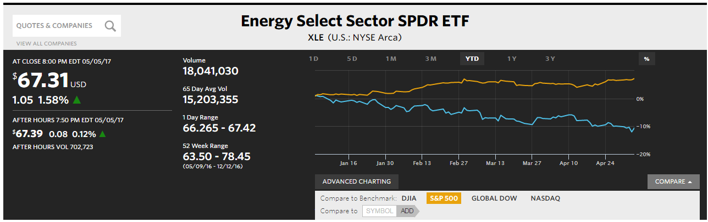
Energy
Performance (YTD):
-6.64%
Portfolio Holdings:
Energy Select Sector SPDR ETF (XLE)
Stocks to Watch:
Chevron (CVX)
Companies in the Energy sector produce, distribute and/or supply energy to consumers. The energy sector is sensitive to the business cycle and the industry works in a more cyclical fashion. Weather and seasons can play critical roles in the industry and cause an increase in demand for gasoline in the summer and a decrease in demand during the winter. The energy industry is known for large capital expenditures, research and development spending, and legal expenses.
The energy sector continues to be volatile as attempts to reduce oil production by OPEC and Trump’s deregulation have caused a stir in the sector. Going into the summer it will be interesting to see how these policies will affect oil and gas companies. The SAP portfolio is currently overweight in the Energy sector.

Slide 16

Financials
Performance(YTD):
1.57%
Portfolio Holdings:
Financial Select Sector SPDR ETF (XLF)
PNC Financial Group (PNC)
BOFI Holding Inc. (BOFI)
Stocks to Watch:
Allstate Corp. (ALL)
Credit Suisse Group AG (ADR)
The Financial Sector is comprised of companies that provide financial services to commercial or retail customers. Banks, Investment Funds, and Insurance Companies make up the financial sector. The financial sector is one of the largest sectors, making up about 14.6% of the S&P 500. The sector performs well when the economy is doing well because there are usually more capital projects and additional investments during times of economic growth and stability.
The sector maintains a 1.57% return Year to Date. This is behind the S&P 500 as it currently is at a 6.97% YTD return. The industry is cooling off after it posted a return of 20% after the election in November. This sector is heavily influenced by politics and policy, and could see more growth if President Trump follows through with regulation repeal and tax cuts.

Slide 17
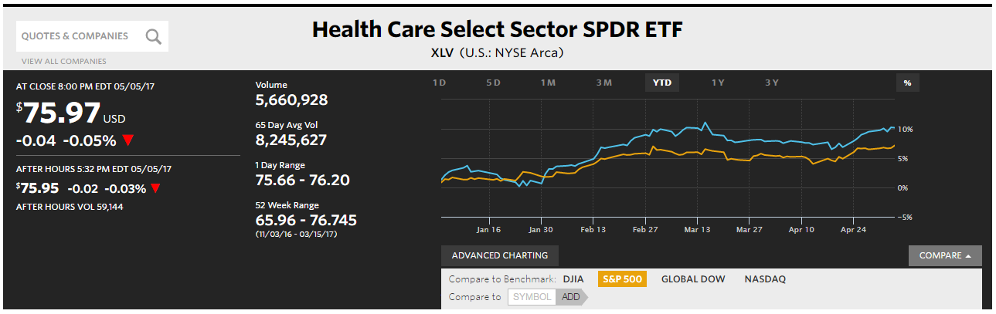
Healthcare
Performance (YTD):
9.91%
Portfolio Holdings:
Health Care SPDR ETF (XLV)
CVS Health Corp (CVS)
Akorn Inc.(AKRX)
Stocks to Watch:
Teva Pharmaceutical Industries (TVA)
Celgene Corporation (CELG)
The healthcare sector is divided among 16 different industries varying between biopharmaceuticals to health care plans. Most notable industries that contribute to the majority of the sector are Biopharmaceuticals, Drugs- Generic, Drug Manufacturers, Health Care Plans, and Medical Appliances & Equipment. 1 Of the USD 7.8 trillion benchmarked to the S&P 500 index, Healthcare is the third largest component of the index with its sector at a 13.7% weight.
The healthcare sector has performed very well with a 9.91% return year to date. This tracks ahead of the S&P return at 6.97%. The sector faces an uncertain rest of 2017 after Obamacare was not repealed or replaced, and the GOP plans on making another run at it.

Slide 18
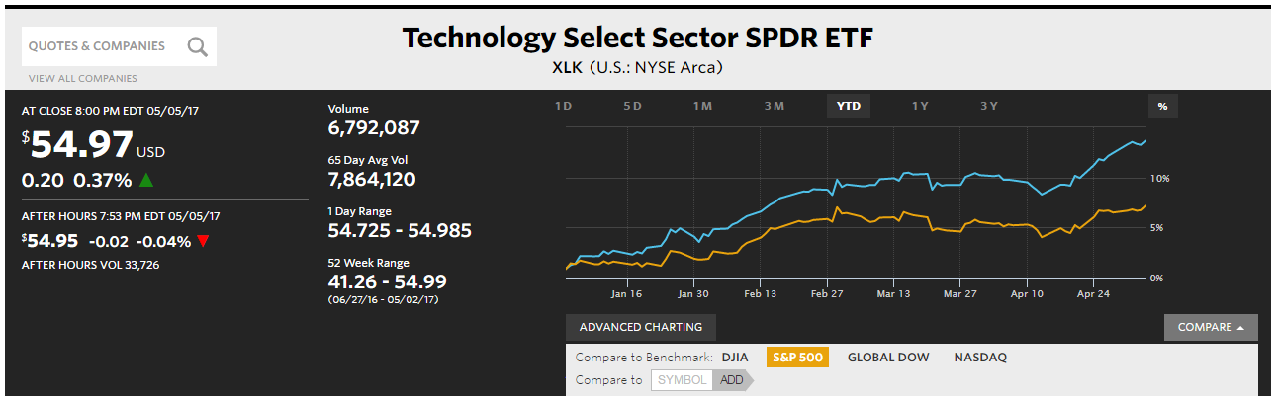
Information Technology
Performance (YTD):
10.66%
Portfolio Holdings:
Adobe (ADBE)
Stamps.com(STMP)
Facebook (FB)
Stocks to Watch:
Amazon (AMZN)
Apple (AAPL)
The Information Technology Sector covers the following general areas: Technology Software & Services, including companies that primarily develop software in various fields such as the Internet, applications, systems, databases management and/or home entertainment, and companies that provide information technology consulting and services, as well as data processing and outsourced services. Demand for IT services is driven by rapid technological advances, but spending depends on the health of the US economy.
The information technology sector has performed very well over the past year where it has outperformed the S&P 500 by roughly 4.5%. The Information Technology ETF contributed positive gains to the SAP portfolio, adding an additional $1,579.27.

Slide 19
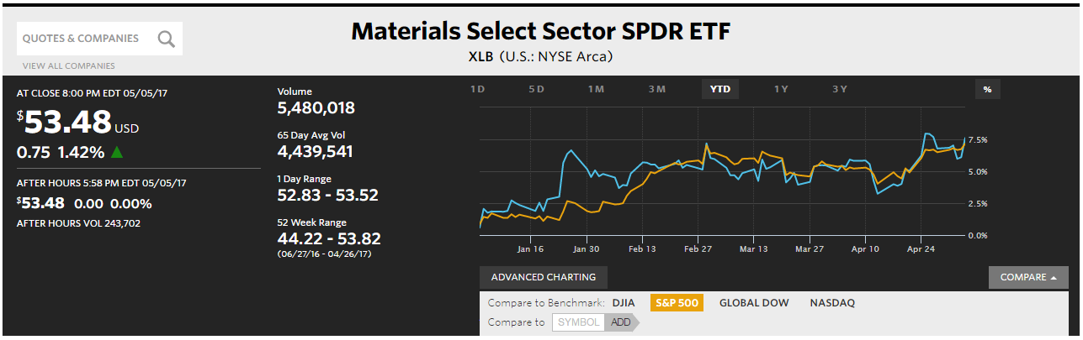
Materials
Performance (YTD):
6.24%
Portfolio Holdings:
Materials Select Sector SPDR ETF (XLB)
DOW Chemicals (DOW)
Stocks to Watch:
Methanex (MEOH)
Vulcan Materials Company (VMC)
Cemex SAB de CV (CX)
Within the Materials Sector are a wide range of commodity-related manufacturing
industries that produce chemicals, metals, paper, glass, forest products, steel, related packaging products, construction materials minerals, and other mining companies. The XLB SPDR Materials ETF is the index that represents Materials in the S&P 500, which currently represents 5.00% of the S&P 500 portfolio.
The graph below shows that the XLB has slightly outperformed the S&P 500 ETF since it was added to our portfolio. Like the industrials sector, the materials sector follows overall market trends fairly similarly.

Slide 20
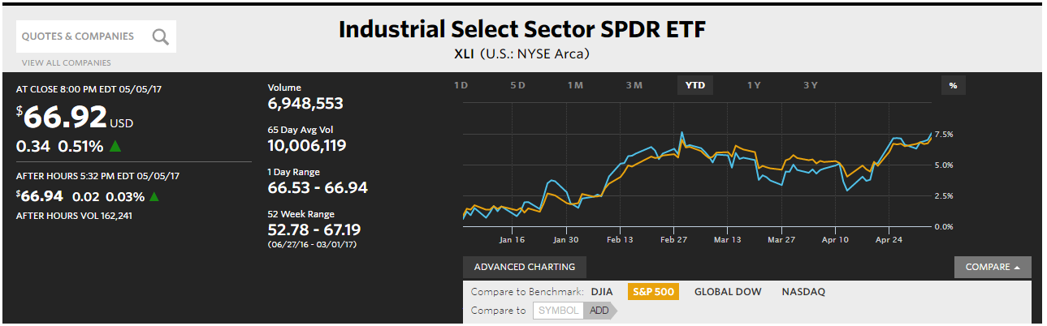
Industrials
Performance (YTD):
6.61%
Portfolio Holdings:
Industrial Select Sector SPDR ETF (XLI)
Delta Airlines (DAL)
Stanley Black & Decker (SWK)
Magna International (MGA)
Stocks to Watch:
Southwest (LUV)
Nordson Corp (NDSN)
United Technologies Corp (UTX)
The Industrials Sector is comprised of companies whose businesses are centered around
the manufacturing and distribution of capital goods, commercial services, and transportation services. The XLI SPDR Industrials ETF is the index that represents Industrials in the S&P 500, which currently represents 10.18% of the S&P 500 portfolio
As evidenced by the chart below, the industrials sector has closely
mirrored the S&P 500 since it was added to our portfolio. This reveals that the industrials sector largely follows trends of the overall market. In the coming months, the Trump fiscal policy is expected to have a large effect on the Industrials sector performance.

Slide 21
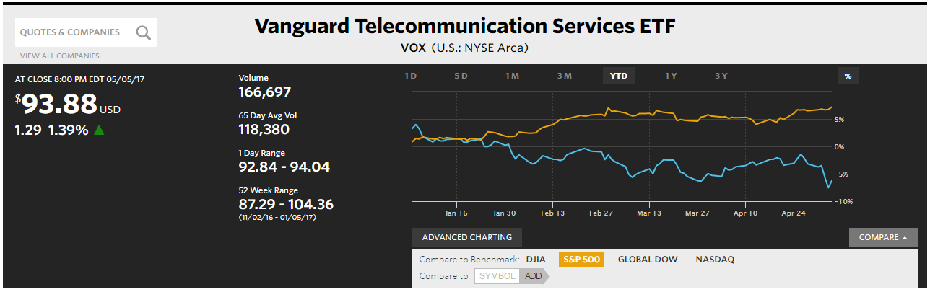
Telecommunications Services
Performance (YTD):
1.74%
Portfolio Holdings:
Telecom ETF (VOX)
Stocks to Watch:
BCE INC (BCE)
The Telecommunication Services sector includes companies that transmit data through communication services using wireless networks, satellite, cable and Internet. They provide the communication and transmission of data to be sent all throughout the world using phone or Internet, both wired and wireless networks. The estimated weight of Telecommunication Services (XTL) in the S&P 500 is about 2.62%.

Slide 22
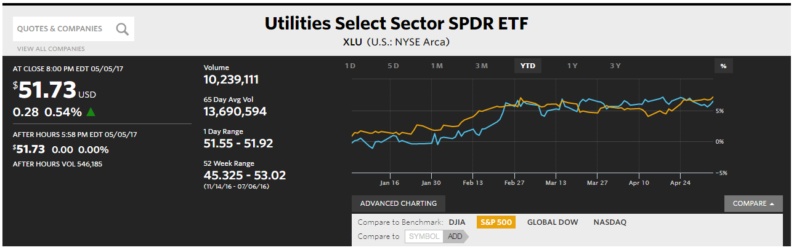
Utilities
Performance (YTD):
6.44%
Portfolio Holdings:
Utilities ETF (XLU)
Stocks to Watch:
Portland General Electric (POR)
PPPL Corp (PPL)
The utilities sector contains electric, gas, and water firms as well as integrated providers of these resources. The sector only accounts for 3.17% of the S&P 500. Some examples of companies in the sector are Duke Energy Corporation (DUK) and American Electric Power Company (AEP). Due to utilities requiring large infrastructure projects, companies often take on debt and are therefore heavily influenced by interest rates.
The sector was underweighted in the SAP portfolio, and comprised of 2.00% of our fund. The sector has a yield to date return of 6.44%. This return just barely trails that of the S&P 500. As interest rates rise in 2017, it can be expected that some of the faster growers in the industry will cool off as financing becomes more expensive.

Slide 23
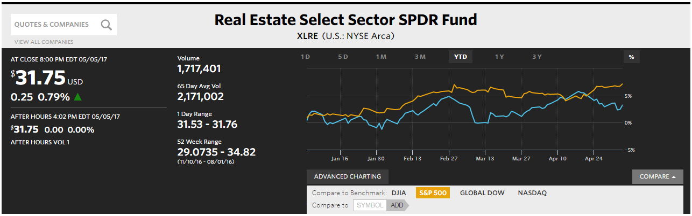
Real Estate
Performance (YTD):
4.75%
Portfolio Holdings:
Real Estate ETF (XLRE)
Stocks to Watch:
Kimco Realty Corp (KIM)
Vornado Realty Trust (VNO)
The Real Estate Sector covers all Real Estate Investment Trusts (REITs) besides Mortgage REITs, which can be found in the Financial sector. Along with REITs, the Real Estate Sector includes Real Estate Management and Development services . The XLRE SPDR Real 16 Estate ETF is the index that represents Real Estate in the S&P 500, which currently represents 2.83% of the S&P 500.
The sector was overweight in the SAP portfolio, and comprised of 1.92% of our fund. The sector has a yield to date return of 4.75%. This return slightly lags that of the S&P 500. As interest rates rise in 2017, it can be expected that some of the faster growers in the industry will cool off as financing becomes more expensive.

Slide 24

PORTFOLIO STRATEGY & COMPOSITION
Spring 2017
Overview
Economic Conditions
Sector Summaries
Portfolio Strategy & Composition
Risk Analysis
Performance Review
Student Biographies

Slide 25
Growth Strategy Overview
To find stocks expected to grow faster than their industry peers
BUY CRITERIA
Conservative Mentality | Expect stock to perform better than the Industry
Revenue Growth | Industry Average and forecasted to continue to grow
Strong Earnings | 5 years of CAGR
ROE | ≥ 15% and > Industry Average
PEG | ≤ 1.2 and < Industry Average
Debt/Equity | < 1.5 (or Acceptable Interest Coverage Ratio when D/E >1.0)
SELL CRITERIA
Price | Price reaches 10% below target price or 20% above purchase price
Leadership | The company’s leadership position changes
Business Fundamentals | Business fundamentals deteriorate
Company slowdown | Slowing unit volume, revenue decline, weak earnings, etc.
Alternative Investments | Superior investment alternatives are identified

Slide 26
Growth Strategy Overview
Stop Loss Criteria
Acquisitions
Given the overall economic uncertainty surrounding the new presidency and international markets, we did not employ any stop losses this semester.
Bank of Internet Holding Inc.
Stamps.com
Akorn Inc.
Adobe Systems Inc.
Michael KORS Holdings
Facebook Inc.
The Walt Disney Company

Slide 27

Bank of Internet Holding Inc. | BOFI
Growth Strategy Position Change
Position
350 Shares | $9,553.39
Buy Criteria
Industry Average
BOFI
Bank of Internet Holding is an online bank holding company that offers their consumers diversified financial services including lending, fee generation, and deposit businesses.
Bank of Internet Holding’s mission is to establish a highly efficient, customer focused, innovative and resilient digital bank that provides the best environment for experienced leaders to develop a diversified portfolio of lending.
Debt/Equity
1.2
1.0
5 years of CAGR
7.4%
30.64%
ROE
7.1%
18.72%
PEG
1.74
1.36
Debt/ Equity

Slide 28

Stamps.com | STMP
Growth Strategy Position Change
Position
180 Shares | $19,773.00
Buy Criteria
Industry Average
BOFI
Stamps.com Inc. is a provider of Internet-based mailing and shipping solutions in the United States. .The Company offers USPS mailing and shipping services, multi-carrier shipping services, mailing and shipping services, branded insurance and international postage solutions.
The Company offers customized postage under the PhotoStamps and PictureItPostage brand names.
Debt/Equity
0.5
0.4
5 years of CAGR
15.1%
29.1%
ROE
8.3%
24.6%
PEG
-
1.2
Debt/ Equity

Slide 29

Akorn Inc. | AKRX
Growth Strategy Position Change
Position
495 Shares | $10,533.60
Buy Criteria
Industry Average
AKRX
Akorn is a pharmaceutical company, founded in 1948 in Lake Forest, Illinois, that develops branded prescription pharmaceuticals. Akorn specializes in ophthalmology, anesthesia, and antidotes. The pharmaceutical company currently employs 1,972 individuals full time.
Akorn’s mission emphasizes that they are “dedicated to improving patients’ lives through the quality, availability and affordability of our products”.
Debt/Equity
1.0
1.0
5 years of CAGR
16.3%
52.2%
ROE
6.2%
25.58%
PEG
-
1.0
Debt/ Equity

Slide 30

Adobe Systems Inc. | ADBE
Growth Strategy Position Change
Position
82 Shares | $10,131.20
Buy Criteria
Industry Average
ADBE
Adobe Systems Inc. is a digital media, digital marketing, and print and publishing software and services offering headquartered in San Jose, California catered for creative professionals, enterprises, and consumers.
Adobe’s mission is “to change the world through digital experiences” and carries a vision “to revolutionize how the world engages with ideas and information”.
Debt/Equity
0.5
0.3
Revenue Growth
11.2%
13.0%
ROE
8.3%
16.2%
PEG
1.77
1.2
Debt/ Equity

Slide 31

Michael KORS Holdings | SCMP
Growth Strategy Position Change
Position
260 Shares | $9,716.00
Buy Criteria
Industry Average
KORS
Debt/
Equity
0.6
0.08*
Michael Kors Holdings Limited is a designer, marketer, distributor and retailer of branded women's apparel and accessories and men's apparel.
Michael Kors is the leading American fashion designer for luxury accessories and sportswear. The company's heritage is rooted in producing polished, sleek, sophisticated American sportswear with a jet-set attitude.
5 years of CAGR
7.8%
42.5%
ROE
15.5%
39.5%
PEG
1.2
0.1
Debt/ Equity
*Morningstar does not report a ratio for D/E because MK does not have any bonds outstanding. Found D/E by dividing short-term debt by total equity, as reported in the latest 10Q.

Slide 32

Facebook Inc. | FB
Growth Strategy Position Change
Position
220 Shares | $29,650
Buy Criteria
Industry Average
FB
Debt/
Equity
1.5
0
“Facebook’s mission is to give people the power to share and make the world more open and connected. People use Facebook to stay connected with friends and family, to discover what’s going on in the world, and to share and express what matters to them.”
5 years of CAGR
33.1%
49.4%
ROE
10.4%
19.7%
PEG
1.86
0.95
Debt/ Equity

Slide 33

The Walt Disney Company | DIS
Growth Strategy Position Change
Position
135 Shares | $15,265.00
Buy Criteria
Industry Average
DIS
Debt/
Equity
1.0
0.3
“The mission of The Walt Disney Company is to be one of the world’s leading producers and providers of entertainment and information. Using our portfolio of brands to our content, services and consumer products, we seek to develop the most creative, innovative and profitable entertainment experiences and related products in the world.”
5 years of CAGR
11.1%
6.3%
ROE
19.7%
20.6%
PEG
6.4
1.19
Debt/ Equity

Slide 34
Value Strategy Overview
To find stocks priced less than their intrinsic value
BUY CRITERIA
Price/Sales | < Industry Average
Price/Book | < Industry Average
Dividends | > Industry Average
Free Cash Flow | Positive
SELL CRITERIA
Mergers or acquisitions | Any news in regards to M&A activity
Earnings | Significant restatement
Executive Management | Changes to management
Price Targets | Exceeds initial price target
Price | Trending downwards towards a stop loss mark

Slide 35
Value Strategy Overview
Stop Loss Criteria
Acquisitions
Ford Motor Company
Comcast
The PNC Financial Services Group, Inc.
CVS Health Corporation
Delta Airlines
Stanley Black & Decker
Magna International
Dow Chemicals
Given the overall economic uncertainty surrounding the new presidency and international markets, we did not employ any stop losses this semester.

Slide 36

Ford Motor Company
Value Strategy Position Change
Position
800 Shares | $9,836.48
Buy Criteria
Industry Average
F
Price/ Sales
0.5
0.3
Ford Motor Company, is a global automotive and mobility company. The Company's business includes designing, manufacturing, marketing, and servicing a line of Ford cars, trucks, and sport utility vehicles, as well as Lincoln luxury vehicles. The Company operates in four segments: Automotive, Financial Services, Ford Smart Mobility LLC, and Central Treasury Operations.
Price/ Book
2.2
1.60
Dividend Yield
4.50%
4.80%
“People working together as a lean, global enterprise to make people’s lives better through automotive and mobility leadership” -Vision Statement
Positive Cash flow
-
$ 12.336 B

Slide 37

Comcast Corporation | CMCSA
Value Strategy Position Change
Position
400 Shares | $15,056
Buy Criteria
Industry Average
CMCSA
Price/ Sales
2.4
1.1
Comcast is a global media and technology company headquartered in Philadelphia, Pennsylvania. Comcast operates under two primary businesses, Comcast Cable and NBCUniversal. Comcast Cable is one of the nations largest video, high-speed internet and phone services to residential customers and businesses. NBCUniversal operates news, entertainment, sports cable networks, NBC networks, television production operations, television station groups and Universal Studios.
Price/ Book
23.7
1.7
Dividend Yield
0.8%
1.5%
Positive Cash flow
-
$8.4 B

Slide 38

The PNC Financial Services Group, Inc.
Value Strategy Position Change
Position
165 Shares | $19,798.93
Buy Criteria
Industry Average
PNC
The PNC Financial Services Group, Inc., is a diversified financial services company. The Company has businesses engaged in retail banking, corporate and institutional banking, asset management and residential mortgage banking, providing its products and services nationally. The Company operates through six segments: Retail Banking, Corporate & Institutional Banking, Asset Management Group, Residential Mortgage Banking, BlackRock and Non-Strategic Assets Portfolio.
Price/ Sales
4.30
4.00
Price/ Book
1.70
1.30
“PNC has long demonstrated a commitment to integrity and corporate responsibility, and its commitment has only deepened as it has grown into one of the leading financial services companies in the country. PNC employees are responsible for living the company’s seven values, which inform how we conduct business.” -Mission Statement
Dividend Yield
1.70%
1.80%
Positive Cash flow
-
$7.95 B

Slide 39

CVS Health Corp | CVS
Value Strategy Position Change
Position
190 Shares | $14,895
Buy Criteria
Industry Average
CVS
CVS Health Corp is an integrated pharmacy health care provider with three operating segments: Pharmacy Services, Retail Pharmacy and Corporate.
“We’re reinventing pharmacy to have a more active, supportive role in each person’s unique health experience and in the greater health care environment.”
Price/ Sales
0.6
0.5
Price/ Book
2.8
2.2
Dividend Yield
1.2%
2.2%
Positive Cash flow
-
$7.85 B

Slide 40

Delta Airlines
Value Strategy Position Changes
Position
360 Shares | $17,175.60
Buy Criteria
Industry Average
DAL
Price/ Sales
1.00
1.00
Delta Air Lines, Inc., provides scheduled air transportation for passengers and cargo throughout the United States and across the world. The Company's segments include Airline and Refinery.
Price/ Book
3.70
3.00
“We—Delta’s employees, customers, and community partners together form a force for positive local and global change, dedicated to bettering standards of living and the environment where we and our customers live and work.” –Mission Statement
Dividend Yield
0.70%
1.50%
Positive Cash flow
-
+

Slide 41

Stanley Black & Decker
Value Strategy Position Changes
Position
115 Shares | $15,153.55
Buy Criteria
Industry Average
SWK
Stanley Black & Decker, Inc., is a global provider of hand tools, power tools and related accessories, mechanical access solutions, such as automatic doors and commercial locking systems, electronic security and monitoring systems, healthcare solutions, engineered fastening systems and products and services for various industrial applications. The Company's segments include Tools & Storage, Security and Industrial. Its Tools & Storage segment consists of the power tools and hand tools, accessories and storage businesses. Its Security segment consists of the convergent security solutions and mechanical access solutions businesses.
Price/ Sales
2.0
1.7
Price/ Book
3.7
3.1
Dividend Yield
1.60%
1.97%
“Stanley Black & Decker provides the tools, solutions, and services that the world counts on when it really matters. We build the tools that build and repair your home and car, we build the tools that build and repair your infrastructure, and we provide the services and solutions that protect what’s most valuable to you.” -Mission Statement
Positive Cash flow
-
+

Slide 42

Magna International | MGA
Value Strategy Position Change
Position
352 Shares | $15,140.04
Buy Criteria
Industry Average
MGA
Price/ Sales
0.8
0.5
Magna International develops, manufactures, engineers, supplies, and sells automotive products. The company offers body and chassis systems, and related engineering services. Magna was founded in 1957 and is headquartered in Aurora, Canada.
Magna has 312 manufacturing operations and 98 product development, engineering, and sales centers in 29 countries.
Price/ Book
2.7
1.7
Dividend Yield
1.50%
2.30%
Positive Cash flow
-
$ 1,579 M

Slide 43

Dow Chemicals
Value Strategy Position Changes
Position
160 Shares | $10,124.80
Buy Criteria
Industry Average
DOW
The Dow Chemical Company (Dow), incorporated on June 11, 1947, is a manufacturer and supplier of products used primarily as raw materials in the manufacture of customer products and services. The Company operates through five segments: Agricultural Sciences, Consumer Solutions, Infrastructure Solutions, Performance Materials & Chemicals, and Performance Plastics.
Price/ Sales
1.5
1.4
Price/ Book
3.6
2.9
Dividend Yield
2.5
3.0
“To passionately create innovation for our stakeholders at the intersection of chemistry, biology, and physics.” –Mission Statement
Positive Cash flow
-
+

Slide 44
Dividend Strategy Overview
To find stocks fairly priced and offering a dividend yield greater than the S&P 500
BUY CRITERIA
Dividend Yield | ≥ SPDR S&P Dividend ETF
Quick Ratio | ≥ Industry Average
Cash Dividends | Positive total cash dividends paid annually
Positive Total Cash | From investing and operating activities
Constant Dividend | Yes
Dividend Growth | Historical and potential dividend growth
SELL CRITERIA
Dividends | Dividends are cut
Free Cash Flow | Diminishes or is no longer positive
Alternative Investments | Superior investment alternatives are identified

Slide 45
Dividend Strategy Overview
Stop Loss Criteria
Acquisitions
Given the overall economic uncertainty surrounding the new presidency and international markets, we did not employ any stop losses this semester.

Slide 46
ETF Strategy Overview
BUY CRITERIA
 | Growth | Value
Average 3 Month Volume | ≥ 600MM Shares | ≥ 600MM Shares
Portfolio P/E | 14 ≤ P/E ≤ 22 | ≤ S&P 500
Beta (3 years) | ≤ 1.25 | ≤ 1
Net Assets | ≥ $250MM | ≥ $250MM
Expense Ratio | ≤ 0.9% | ≤ 0.9%
SELL CRITERIA
Price/Earnings | Does not meet criteria
Price | Drops 10%
Position Change
All Spdr ETFs were purchased or sold in order to utilize the cash in our portfolio while waiting for investment decisions to be made.

Slide 47
RISK ANALYSIS
Spring 2017
Overview
Economic Conditions
Sector Summaries
Portfolio Strategy & Composition
Risk Analysis
Performance Review
Student Biographies

Slide 48
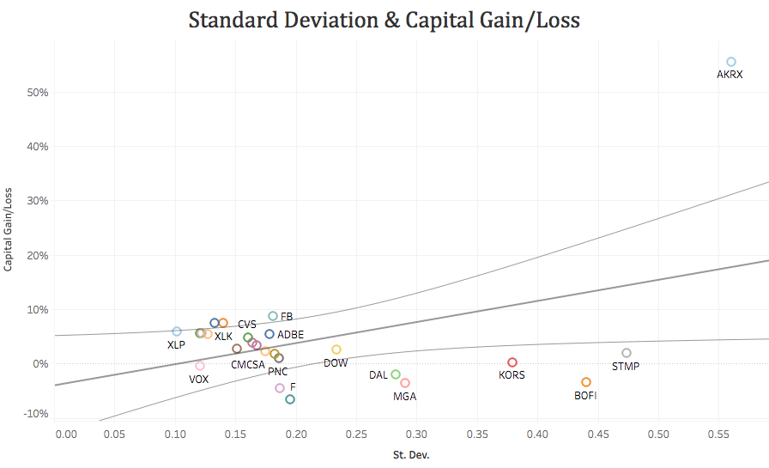
Portfolio Risk Analysis: Standard Deviation
SAP
σ = 18.57%
S&P 500
σ = 10.38%
VS.
Sharpe Ratio
SAP
0.9
<
S&P 500
1.2

Slide 49
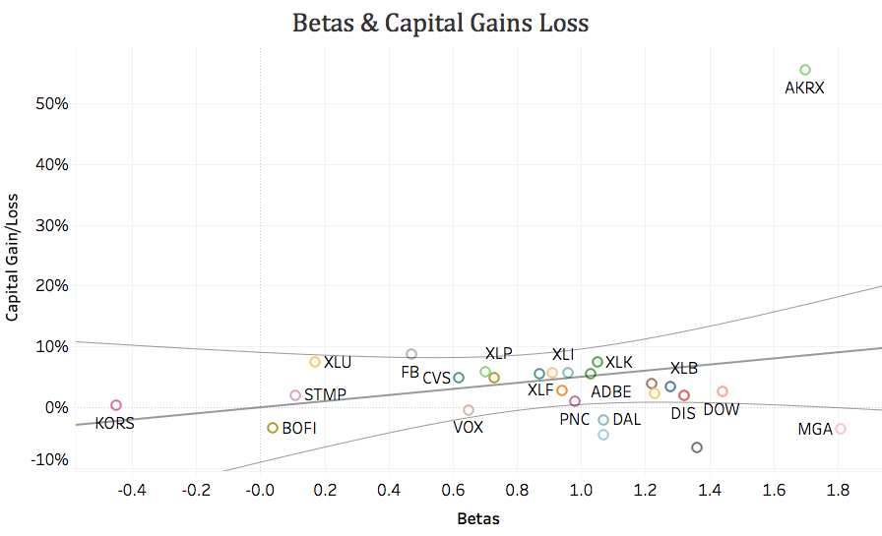
Portfolio Risk Analysis: Beta
SAP
β = .88
S&P 500
β = 1.0
VS.
Akorn, Magna, & Dow
  Highest betas in the Spring 2017 SAP fund

Slide 50
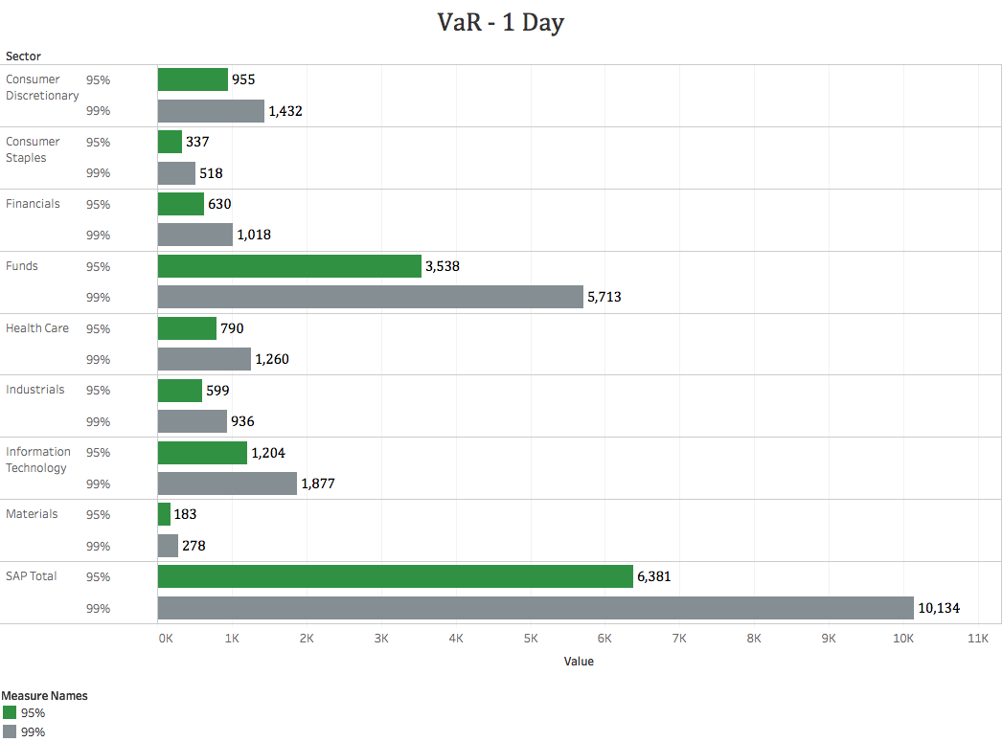
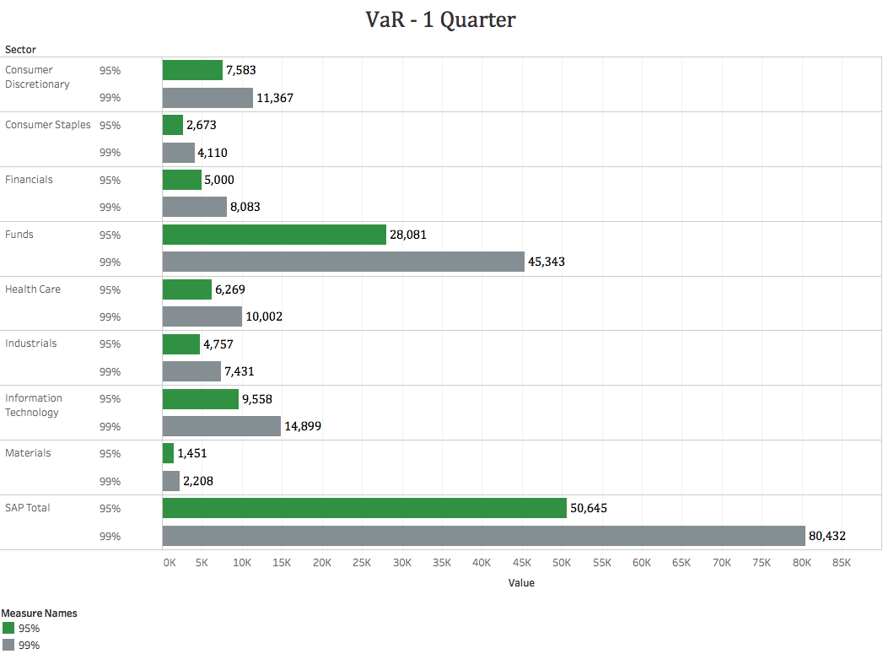
Value at Risk

Slide 51
Correlation Matrix
 | ADBE | AKRX | BOFI | CMCSA | CVS | DAL | DIS | DOW | F | FB | KORS | MGA | PNC | STMP | SWK | VOX | XLB | XLE | XLF | XLI | XLK | XLP | XLRE | XLU | XLV | XLY
ADBE | 1.00
AKRX | 0.17 | 1.00
BOFI | 0.19 | 0.14 | 1.00
CMCSA | 0.37 | 0.21 | 0.16 | 1.00
CVS | 0.34 | 0.14 | 0.17 | 0.33 | 1.00
DAL | 0.41 | 0.19 | 0.25 | 0.34 | 0.26 | 1.00
DIS | 0.43 | 0.14 | 0.21 | 0.61 | 0.31 | 0.38 | 1.00
DOW | 0.35 | 0.18 | 0.16 | 0.42 | 0.27 | 0.31 | 0.38 | 1.00
F | 0.37 | 0.18 | 0.28 | 0.42 | 0.26 | 0.45 | 0.48 | 0.41 | 1.00
FB | 0.50 | 0.21 | 0.17 | 0.36 | 0.29 | 0.32 | 0.33 | 0.29 | 0.32 | 1.00
KORS | 0.20 | 0.07 | 0.10 | 0.16 | 0.12 | 0.20 | 0.18 | 0.32 | 0.22 | 0.19 | 1.00
MGA | 0.39 | 0.13 | 0.28 | 0.31 | 0.28 | 0.46 | 0.42 | 0.41 | 0.65 | 0.29 | 0.23 | 1.00
PNC | 0.46 | 0.22 | 0.43 | 0.45 | 0.33 | 0.49 | 0.48 | 0.47 | 0.54 | 0.33 | 0.21 | 0.52 | 1.00
STMP | 0.29 | 0.12 | 0.16 | 0.17 | 0.08 | 0.25 | 0.28 | 0.13 | 0.21 | 0.17 | 0.10 | 0.29 | 0.25 | 1.00
SWK | 0.54 | 0.14 | 0.31 | 0.47 | 0.34 | 0.43 | 0.46 | 0.48 | 0.52 | 0.34 | 0.24 | 0.50 | 0.60 | 0.19 | 1.00
VOX | 0.49 | 0.22 | 0.23 | 0.52 | 0.34 | 0.40 | 0.49 | 0.44 | 0.53 | 0.38 | 0.23 | 0.45 | 0.48 | 0.23 | 0.51 | 1.00
XLB | 0.50 | 0.23 | 0.24 | 0.56 | 0.37 | 0.46 | 0.52 | 0.80 | 0.59 | 0.37 | 0.34 | 0.59 | 0.66 | 0.22 | 0.66 | 0.61 | 1.00
XLE | 0.42 | 0.24 | 0.21 | 0.45 | 0.29 | 0.31 | 0.43 | 0.56 | 0.52 | 0.33 | 0.26 | 0.46 | 0.54 | 0.15 | 0.48 | 0.55 | 0.76 | 1.00
XLF | 0.54 | 0.26 | 0.41 | 0.56 | 0.42 | 0.56 | 0.58 | 0.54 | 0.64 | 0.41 | 0.24 | 0.59 | 0.91 | 0.28 | 0.66 | 0.60 | 0.75 | 0.63 | 1.00
XLI | 0.57 | 0.23 | 0.33 | 0.62 | 0.45 | 0.59 | 0.58 | 0.62 | 0.67 | 0.45 | 0.30 | 0.61 | 0.75 | 0.24 | 0.75 | 0.68 | 0.86 | 0.69 | 0.86 | 1.00
XLK | 0.70 | 0.28 | 0.27 | 0.59 | 0.43 | 0.54 | 0.59 | 0.53 | 0.57 | 0.66 | 0.25 | 0.57 | 0.63 | 0.32 | 0.65 | 0.69 | 0.72 | 0.59 | 0.74 | 0.81 | 1.00
XLP | 0.54 | 0.12 | 0.16 | 0.52 | 0.51 | 0.38 | 0.47 | 0.41 | 0.40 | 0.47 | 0.20 | 0.38 | 0.40 | 0.15 | 0.51 | 0.62 | 0.56 | 0.46 | 0.55 | 0.67 | 0.72 | 1.00
XLRE | 0.45 | 0.06 | 0.15 | 0.33 | 0.28 | 0.31 | 0.34 | 0.23 | 0.29 | 0.29 | 0.19 | 0.31 | 0.20 | 0.06 | 0.36 | 0.54 | 0.40 | 0.29 | 0.37 | 0.45 | 0.47 | 0.61 | 1.00
XLU | 0.30 | 0.00 | 0.01 | 0.34 | 0.24 | 0.12 | 0.23 | 0.24 | 0.16 | 0.24 | 0.13 | 0.11 | 0.05 | -0.02 | 0.24 | 0.46 | 0.30 | 0.27 | 0.19 | 0.35 | 0.39 | 0.66 | 0.57 | 1.00
XLV | 0.54 | 0.46 | 0.29 | 0.54 | 0.50 | 0.48 | 0.50 | 0.45 | 0.49 | 0.45 | 0.21 | 0.43 | 0.58 | 0.25 | 0.57 | 0.56 | 0.62 | 0.50 | 0.69 | 0.69 | 0.72 | 0.58 | 0.36 | 0.28 | 1.00
XLY | 0.67 | 0.27 | 0.32 | 0.67 | 0.46 | 0.58 | 0.70 | 0.52 | 0.65 | 0.61 | 0.34 | 0.60 | 0.64 | 0.33 | 0.66 | 0.68 | 0.71 | 0.58 | 0.77 | 0.82 | 0.86 | 0.71 | 0.54 | 0.36 | 0.72 | 1.00

Slide 52
Covariance Matrix
 | ADBE | AKRX | BOFI | CMCSA | CVS | DAL | DIS | DOW | F | FB | KORS | MGA | PNC | STMP | SWK | VOX | XLB | XLE | XLF | XLI | XLK | XLP | XLRE | XLU | XLV | XLY
ADBE | 2.122 | 0.972 | 0.979 | 0.609 | 0.654 | 1.114 | 0.738 | 0.807 | 0.829 | 1.191 | 0.748 | 1.052 | 0.915 | 1.417 | 0.947 | 0.696 | 0.813 | 0.91 | 0.911 | 0.788 | 1.02 | 0.61 | 0.644 | 0.424 | 0.803 | 0.903
AKRX | 0.972 | 15.524 | 1.941 | 0.931 | 0.742 | 1.426 | 0.654 | 1.079 | 1.112 | 1.353 | 0.678 | 0.948 | 1.195 | 1.608 | 0.667 | 0.857 | 1.024 | 1.392 | 1.164 | 0.851 | 1.092 | 0.356 | 0.258 | 0.014 | 1.866 | 0.972
BOFI | 0.979 | 1.941 | 12.246 | 0.624 | 0.796 | 1.672 | 0.85 | 0.885 | 1.508 | 0.991 | 0.929 | 1.811 | 2.082 | 1.842 | 1.309 | 0.797 | 0.955 | 1.124 | 1.661 | 1.102 | 0.951 | 0.435 | 0.527 | 0.026 | 1.04 | 1.034
CMCSA | 0.609 | 0.931 | 0.624 | 1.274 | 0.489 | 0.73 | 0.804 | 0.744 | 0.723 | 0.66 | 0.47 | 0.647 | 0.693 | 0.642 | 0.646 | 0.576 | 0.702 | 0.761 | 0.734 | 0.663 | 0.662 | 0.461 | 0.349 | 0.374 | 0.623 | 0.7
CVS | 0.654 | 0.742 | 0.796 | 0.489 | 1.75 | 0.653 | 0.476 | 0.565 | 0.534 | 0.634 | 0.411 | 0.675 | 0.592 | 0.343 | 0.543 | 0.44 | 0.542 | 0.584 | 0.64 | 0.556 | 0.567 | 0.53 | 0.387 | 0.313 | 0.668 | 0.557
DAL | 1.114 | 1.426 | 1.672 | 0.73 | 0.653 | 3.549 | 0.844 | 0.915 | 1.305 | 0.997 | 0.988 | 1.609 | 1.269 | 1.552 | 0.979 | 0.731 | 0.959 | 0.865 | 1.219 | 1.054 | 1.017 | 0.556 | 0.591 | 0.216 | 0.923 | 1.001
DIS | 0.738 | 0.654 | 0.85 | 0.804 | 0.476 | 0.844 | 1.36 | 0.697 | 0.856 | 0.63 | 0.53 | 0.9 | 0.771 | 1.096 | 0.644 | 0.556 | 0.676 | 0.762 | 0.774 | 0.639 | 0.682 | 0.43 | 0.355 | 0.259 | 0.589 | 0.755
DOW | 0.807 | 1.079 | 0.885 | 0.744 | 0.565 | 0.915 | 0.697 | 2.457 | 0.981 | 0.743 | 1.311 | 1.198 | 1.022 | 0.695 | 0.903 | 0.683 | 1.406 | 1.319 | 0.973 | 0.907 | 0.823 | 0.503 | 0.336 | 0.362 | 0.713 | 0.748
F | 0.829 | 1.112 | 1.508 | 0.723 | 0.534 | 1.305 | 0.856 | 0.981 | 2.342 | 0.801 | 0.886 | 1.837 | 1.145 | 1.09 | 0.958 | 0.795 | 1.014 | 1.194 | 1.119 | 0.96 | 0.872 | 0.48 | 0.464 | 0.23 | 0.759 | 0.918
FB | 1.191 | 1.353 | 0.991 | 0.66 | 0.634 | 0.997 | 0.63 | 0.743 | 0.801 | 2.707 | 0.819 | 0.873 | 0.75 | 0.947 | 0.673 | 0.611 | 0.687 | 0.821 | 0.783 | 0.692 | 1.088 | 0.603 | 0.476 | 0.375 | 0.752 | 0.925
KORS | 0.748 | 0.678 | 0.929 | 0.47 | 0.411 | 0.988 | 0.53 | 1.311 | 0.886 | 0.819 | 6.684 | 1.105 | 0.759 | 0.853 | 0.764 | 0.585 | 0.982 | 1.029 | 0.725 | 0.723 | 0.634 | 0.402 | 0.459 | 0.315 | 0.557 | 0.812
MGA | 1.052 | 0.948 | 1.811 | 0.647 | 0.675 | 1.609 | 0.9 | 1.198 | 1.837 | 0.873 | 1.105 | 3.445 | 1.324 | 1.789 | 1.128 | 0.813 | 1.219 | 1.295 | 1.263 | 1.065 | 1.062 | 0.551 | 0.591 | 0.203 | 0.805 | 1.022
PNC | 0.915 | 1.195 | 2.082 | 0.693 | 0.592 | 1.269 | 0.771 | 1.022 | 1.145 | 0.75 | 0.759 | 1.324 | 1.895 | 1.16 | 1.001 | 0.644 | 1.018 | 1.118 | 1.436 | 0.967 | 0.864 | 0.425 | 0.274 | 0.07 | 0.817 | 0.817
STMP | 1.417 | 1.608 | 1.842 | 0.642 | 0.343 | 1.552 | 1.096 | 0.695 | 1.09 | 0.947 | 0.853 | 1.789 | 1.16 | 11.308 | 0.791 | 0.76 | 0.809 | 0.757 | 1.093 | 0.764 | 1.061 | 0.392 | 0.192 | -0.077 | 0.853 | 1.02
SWK | 0.947 | 0.667 | 1.309 | 0.646 | 0.543 | 0.979 | 0.644 | 0.903 | 0.958 | 0.673 | 0.764 | 1.128 | 1.001 | 0.791 | 1.473 | 0.605 | 0.896 | 0.88 | 0.928 | 0.857 | 0.791 | 0.48 | 0.452 | 0.284 | 0.703 | 0.735
VOX | 0.696 | 0.857 | 0.797 | 0.576 | 0.44 | 0.731 | 0.556 | 0.683 | 0.795 | 0.611 | 0.585 | 0.813 | 0.644 | 0.76 | 0.605 | 0.963 | 0.675 | 0.806 | 0.674 | 0.624 | 0.675 | 0.476 | 0.525 | 0.44 | 0.557 | 0.615
XLB | 0.813 | 1.024 | 0.955 | 0.702 | 0.542 | 0.959 | 0.676 | 1.406 | 1.014 | 0.687 | 0.982 | 1.219 | 1.018 | 0.809 | 0.896 | 0.675 | 1.254 | 1.275 | 0.973 | 0.906 | 0.799 | 0.49 | 0.436 | 0.321 | 0.706 | 0.734
XLE | 0.91 | 1.392 | 1.124 | 0.761 | 0.584 | 0.865 | 0.762 | 1.319 | 1.194 | 0.821 | 1.029 | 1.295 | 1.118 | 0.757 | 0.88 | 0.806 | 1.275 | 2.267 | 1.088 | 0.975 | 0.886 | 0.537 | 0.436 | 0.4 | 0.762 | 0.808
XLF | 0.911 | 1.164 | 1.661 | 0.734 | 0.64 | 1.219 | 0.774 | 0.973 | 1.119 | 0.783 | 0.725 | 1.263 | 1.436 | 1.093 | 0.928 | 0.674 | 0.973 | 1.088 | 1.327 | 0.929 | 0.853 | 0.498 | 0.429 | 0.215 | 0.805 | 0.824
XLI | 0.788 | 0.851 | 1.102 | 0.663 | 0.556 | 1.054 | 0.639 | 0.907 | 0.96 | 0.692 | 0.723 | 1.065 | 0.967 | 0.764 | 0.857 | 0.624 | 0.906 | 0.975 | 0.929 | 0.886 | 0.76 | 0.491 | 0.403 | 0.322 | 0.661 | 0.715
XLK | 1.02 | 1.092 | 0.951 | 0.662 | 0.567 | 1.017 | 0.682 | 0.823 | 0.872 | 1.088 | 0.634 | 1.062 | 0.864 | 1.061 | 0.791 | 0.675 | 0.799 | 0.886 | 0.853 | 0.76 | 0.994 | 0.56 | 0.441 | 0.373 | 0.736 | 0.792
XLP | 0.61 | 0.356 | 0.435 | 0.461 | 0.53 | 0.556 | 0.43 | 0.503 | 0.48 | 0.603 | 0.402 | 0.551 | 0.425 | 0.392 | 0.48 | 0.476 | 0.49 | 0.537 | 0.498 | 0.491 | 0.56 | 0.609 | 0.45 | 0.497 | 0.461 | 0.513
XLRE | 0.644 | 0.258 | 0.527 | 0.349 | 0.387 | 0.591 | 0.355 | 0.336 | 0.464 | 0.476 | 0.459 | 0.591 | 0.274 | 0.192 | 0.452 | 0.525 | 0.436 | 0.436 | 0.429 | 0.403 | 0.441 | 0.45 | 1.074 | 0.554 | 0.339 | 0.469
XLU | 0.424 | 0.014 | 0.026 | 0.374 | 0.313 | 0.216 | 0.259 | 0.362 | 0.23 | 0.375 | 0.315 | 0.203 | 0.07 | -0.077 | 0.284 | 0.44 | 0.321 | 0.4 | 0.215 | 0.322 | 0.373 | 0.497 | 0.554 | 0.943 | 0.279 | 0.32
XLV | 0.803 | 1.866 | 1.04 | 0.623 | 0.668 | 0.923 | 0.589 | 0.713 | 0.759 | 0.752 | 0.557 | 0.805 | 0.817 | 0.853 | 0.703 | 0.557 | 0.706 | 0.762 | 0.805 | 0.661 | 0.736 | 0.461 | 0.339 | 0.279 | 1.04 | 0.678
XLY | 0.903 | 0.972 | 1.034 | 0.7 | 0.557 | 1.001 | 0.755 | 0.748 | 0.918 | 0.925 | 0.812 | 1.022 | 0.817 | 1.02 | 0.735 | 0.615 | 0.734 | 0.808 | 0.824 | 0.715 | 0.792 | 0.513 | 0.469 | 0.32 | 0.678 | 0.853

Slide 53
Stress Testing
 | Equities down 10% | Equities up 10% | EUR down 10% vs. USD | EUR up 10% vs. USD | Greece Financial Crisis - 2015 | Oil prices Drop - May 2010 | Debt Ceiling Crisis & Downgrade in 2011 | Lehman Default - 2008
SAP | -11.40% | 11.40% | 1.49% | -1.49% | -3.82% | -9.74% | -17.38% | -20.01%
Consumer Discretionary | -13.50% | 13.50% | -0.11% | 0.11% | -4.41% | -10.02% | -18.44% | -29.55%
Consumer Staples | -9.50% | 9.50% | 0.38% | -0.38% | -3.98% | -4.77% | -9.45% | -20.40%
Financials | -15.75% | 15.75% | 6.26% | -6.26% | -4.00% | -11.74% | -22.68% | 6.46%
Funds | -10.77% | 10.77% | 1.21% | -1.21% | -3.63% | -10.51% | -17.14% | -20.14%
Health Care | -11.24% | 11.24% | 6.96% | -6.96% | -5.82% | -12.66% | -24.75% | -16.54%
Industrials | -13.19% | 13.19% | 1.95% | -1.95% | -2.26% | -2.41% | -15.41% | -17.84%
Information Technology | -11.79% | 11.79% | 1.61% | -1.61% | -4.55% | -10.00% | -18.58% | -25.56%
Materials | -12.70% | 12.70% | -0.45% | 0.45% | -6.19% | -12.69% | -20.54% | -26.44%

Slide 54

PERFORMANCE
Spring 2017
Overview
Economic Conditions
Sector Summaries
Portfolio Strategy & Composition
Risk Analysis
Performance Review
Student Biographies

Slide 55
Portfolio Performance Spring Semester 2017
Academic Year | SAP Portfolio | Raw Return: 11.92% | Annualized Return: 18.60%
 | S&P 500 | Raw Return: 9.74% | Annualized Return: 15.11%
Spring Semester | SAP Portfolio | Raw Return: 5.87% | Annualized Return: 22.38%
 | S&P 500 | Raw Return: 5.44% | Annualized Return: 20.63%

Slide 56
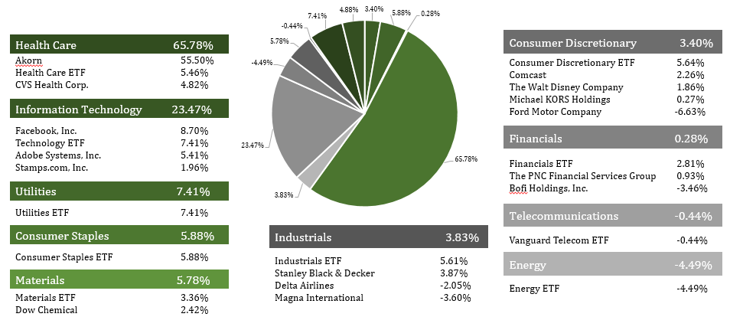
Portfolio Performance by Sector

Slide 57
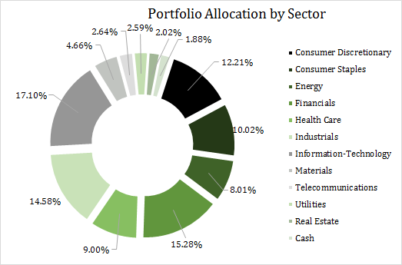
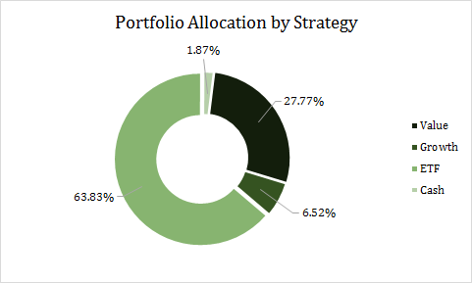
Portfolio Weights Spring Semester 2017

Slide 58
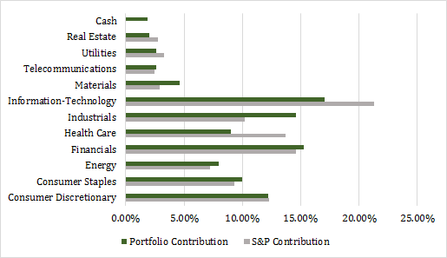
Sector Allocation vs S&P 500

Slide 59
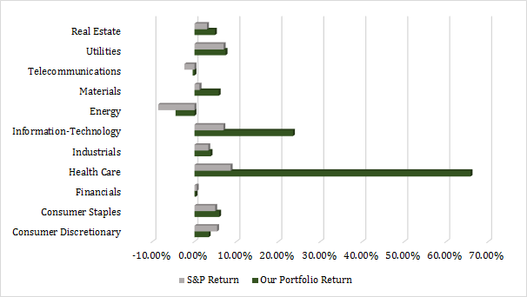
Portfolio Returns vs. S&P 500

Slide 60
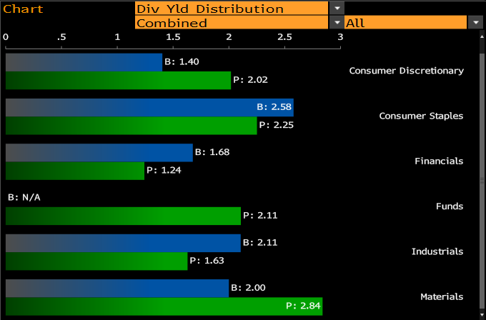
Dividend Performance vs S&P 500
B denotes the S&P 500
P denotes the SAP Portfolio

Slide 61
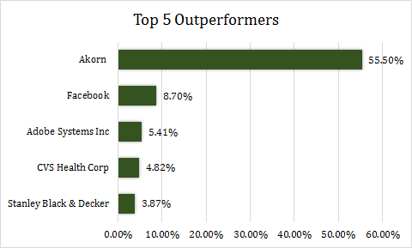
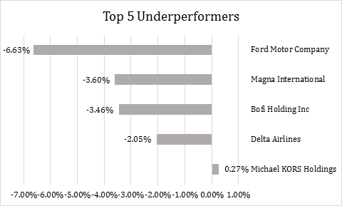
Performance

Slide 62
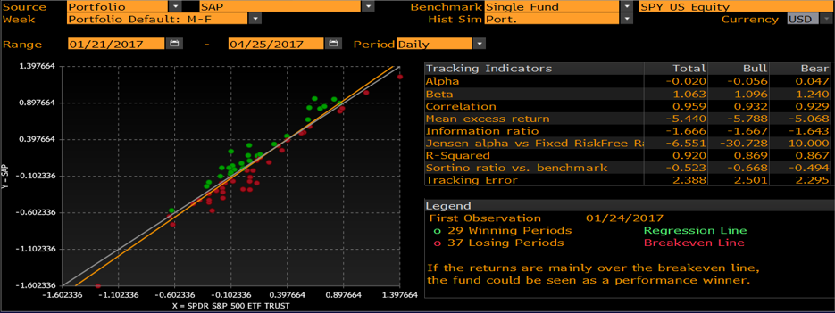
Portfolio Performance

Slide 63
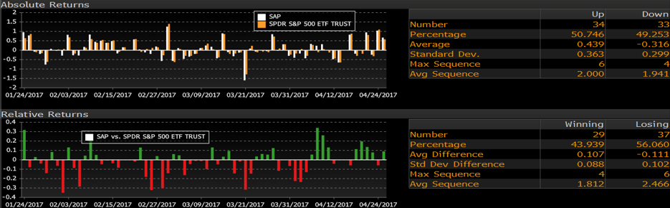
Absolute & Relative Returns

Slide 64
STUDENT BIOGRAPHIES
Spring 2016
Overview
Economic Conditions
Sector Summaries
Portfolio Strategy & Composition
Risk Analysis
Performance Review
Student Biographies

Slide 65


Biographies
Domenique Angiello is an undergraduate student pursuing a Bachelors of Business Administration with a concentration in Finance at Loyola University Maryland, where she is expected to graduate with honors. Domenique previously interned with Loop Capital Markets and CFG Capital Markets. Upon graduating, she will return to Loop Capital’s New York office as an investment banking analyst. Domenique considers Cape Cod to be her second home, and is looking forward to relaxing on the beach with family and friends before starting work.
Domenique Angiello
Giovanni Barr is an undergraduate student who is pursuing a Bachelor’s of Business Administration degree with a concentration in Finance at Loyola University Maryland. Accompanying his studies, Giovanni is the Vice President of the Financial Management Association, and a member of the Baltimore CFA Society. Giovanni previously interned with RBC Wealth Management and Blue Point Investments where he accepted a full-time position as a Client Associate for RBC Wealth Management.
Giovanni Barr

Slide 66


Biographies
Tim Bontempi is an undergraduate student pursuing a Bachelors of Business Administration with a concentration in Finance and a minor in Economics. He is a member of The Sellinger Scholars and is the president and founder of the Sellinger Microfinance Club. He previously interned with Northrop Grumman in the Financial Planning and Reporting team in Baltimore. He will be returning to Northrop Grumman’s professional Development Program following graduation.
Timothy Bontempi
Nicholas Constantine is an undergraduate student pursuing a Bachelors of Business Administration with a concentration in Finance from the Sellinger School of Business at Loyola University Maryland. Last summer Nicholas interned at Morgan Stanley where he was an Operations Analyst and most recently represented Loyola in the 2016-17 CFA Research Challenge. After graduation Nicholas will be working in New York City as underwriter for AIG.
Nicholas Constantine

Slide 67


Biographies
Craig Cummings is an undergraduate student pursuing a Bachelors of Business Administration with a concentration in Finance at Loyola University Maryland. During his Junior year, Craig studied abroad at Newcastle University in Newcastle England and had been a member of the study abroad ambassadors since Junior year. In addition to his studies, He has had two summer internships at both Cantor Fitzgerald, and Oppenheimer & Co. Upon graduating, Craig will be searching for employment in the financial sector in New York City or Baltimore City.
Craig Cummings
Connor Flach is a senior at Loyola, working towards a Bachelor’s degree in Business Administration with a specialization in Finance, and a minor in Economics. He is a member of the golf team. Upon graduation, he will enroll in the Emerging Leaders MBA program here at Loyola. Connor has internship experience with M&T Bank and UBS. Connor can be contacted via email at ctflach@loyola.edu.
Connor Flach

Slide 68


Biographies
Nicoletti Frank is an undergraduate student who is pursuing a Bachelor’s of Business Administration degree with a concentration in Finance at Loyola University Maryland, graduating May 2017. In addition to her studies, Nicoletti is a member of the Investment Committee for Frank Industries. Inc. Nicoletti previously interned at a technology startup called Fixt. She is actively pursuing possible job opportunities for a position as a financial analyst. She can be reached via email at njfrank1@loyola.edu or by phone at (410)-245-6565.
Nicoletti Frank
Peter Gasparro is an undergraduate student at Loyola University Maryland pursuing a B.B.A with a concentration in Finance from the Sellinger School of Business. In addition to his rigorous academic studies, Peter worked as a Summer Associate in Contract Binding Operations at Arch Capital Group Ltd. Arch offers worldwide risk management and insurance solutions. In addition, Peter has also had the pleasure of working with Suth Equities as a Summer Analyst. After graduation, Peter will be studying for the LSAT exam to attend law school in the New York City area. He may be contacted through his email at pgasparro@me.com
Peter Gasparro

Slide 69


Biographies
Carl Gatzendorfer is an undergraduate student pursuing a Bachelors of Business Administration with a concentration in Finance at Loyola University Maryland. He is the President of the Club Baseball team and an Intramural Sports Supervisor at the Fitness and Aquatic Center. Carl previously interned with New York Life and HMS Insurance Associates and will be working in Charlotte, NC after graduation.
Carl Gatzendorfer
Nathalia Gracia is an undergraduate student pursuing a B.B.A in Finance from the Selling School of Business and Management at Loyola University Maryland, graduating in May 2017. In addition to her studies, Nathalia participates on the board of Financial Management Association as the Vice President of Events. Previously, Nathalia was a Private Wealth Management Intern at UBS Financial Services. She is incredibly interested in pursuing a career as a financial data analyst. She can be reached by email at ngracia@loyola.edu or by phone at (631) 702-0987.
Nathalia Gracia

Slide 70


Biographies
Juliana Hart is an undergraduate student pursuing a Bachelors of Business Administration with a concentration in Finance at Loyola University Maryland. In addition to her studies, Juliana works as a student intern at Loyola’s Center for Community Service and Justice. Following graduation in May 2017, Juliana will be working as a Tax Audit Analysts at Comcast Corporation in Philadelphia, Pennsylvania.
Juliana Hart
Shane Heizer is a rising senior at Loyola pursuing a BBA in Finance with minors in Economics and Philosophy. He enjoys research, particularly when it is related to business. He specifically enjoys understanding companies that are upending industries and that are on the forefront of innovation. Shane has previously worked as a commercial credit analyst underwriting commercial real estate, working capital lines of credits and installment loans for capex. He will be going back to the same regional bank this summer to continue underwriting in the commercial department. Shane can be contacted at sheizer@loyola.edu.
Shane Heizer

Slide 71


Biographies
Dillon M. Johnston is an undergraduate student pursuing a Bachelors of Business Administration with a concentration in Finance and a minor in Information Systems at Loyola University Maryland. He is expected to graduate cum laude and is a member of the Financial Management Association National Honor Society. In addition, Dillon has also been a DJ host on WLOY radio and a singer in Loyola’s chapel choir. Dillon is from Princeton, New Jersey and has interned with M&T’s Business Capital Group with whom he will return upon graduation with as a Field Examiner and Portfolio Manager
Dillon Johnston
Max Kiley is a senior at Loyola University Maryland pursuing a Bachelors of Business Administration with a dual concentration in Finance and Information Systems. Upon graduation, he will join Accenture as Financial Analyst in Arlington, Va. Max has previously held two internships with Fannie Mae working for their Credit Risk Analytics Team and Innovation Lab. Max can be contacted at makiley@loyola.edu.
Malcolm Kiley

Slide 72


Biographies
Tyler Larson is an undergraduate student from Bergen County, New Jersey pursuing a Bachelor of Business Administration from the Joseph A. Sellinger School of Business and Management at Loyola University Maryland with a concentration in Finance and minors in Mathematics and Economics. In addition to his undergraduate studies, he has interned at Ameriprise Financial and the National Basketball Association.
Tyler Larson
David J. Lizotte is a senior at Loyola University Maryland pursuing a Bachelors in Business Administration with a concentration in Finance. Upon graduation, he will work in Boston as a Business Development Representative at Rapid7. David has had prior work experience as an Financial Analyst Intern for DELL EMC and an Accounts Payable Intern for BJ’s Wholesale Club. He can be contacted at djlizotte@loyola.edu.
David Lizotte

Slide 73


Biographies
Tyler MacDougall is a senior undergraduate student pursuing a Bachelors of Business Administration with a concentration in Finance and a minor in Information Systems at Loyola University. In addition to his studies, Tyler has gained experience as an intern in the finance department of growing e-solutions firm in the Philadelphia area. After graduation, Tyler will pursue his Juris Doctorate at the Villanova School of Law.
Tyler MacDougall
John Rast is an undergraduate student pursuing a B.B.A. in Finance from the Sellinger School of Business and Management at Loyola University Maryland graduating May 2017. Accompanying his studies he is a member of the Loyola Division 1 Men's Tennis team as well as a member of the Student-Athlete Advisory Committee. Rast will be joining The Vanguard Group after graduation as a Client Relations Associate. In his free time, Rast enjoys surfing and playing pick up sports. He can be reached at jcriii38@gmail.com, or by phone at (803)-238-0971.
John Rast

Slide 74


Biographies
William Robinson is an undergraduate student pursuing a B.B.A. with a concentration in Finance at Loyola University Maryland. In addition to his studies, William has interned with numerous companies that focused on financial services such as, The Ernsky Group and Colonial Life Insurance. In the Fall of 2017, William will be continuing his education at Loyola University as he plans to receive a Master’s degree in Business Administration. He is open to career opportunities and can be reached via email at wfrobinson@loyola.edu or by phone at (614) 302-1649.
William Robinson
Andrew Wagner is an undergraduate student pursuing a Bachelors of Business Administration with a concentration in Finance, and a minor in Information Systems at Loyola University Maryland. In addition to his studies, Andrew has partnered with Wasabi Ventures where he built his own education startup. Andrew plans on staying home in Baltimore, MD post graduation.
Andrew Wagner

Slide 75


Biographies
Laura Waters is an undergraduate student pursuing a Bachelors of Business Administration with a concentration in Finance and a minor in Mathematics at Loyola University Maryland Sellinger School of Business. Laura is from Red Bank, New Jersey and is currently a member of the Financial Management Association and Beta Gamma Sigma. Along with her studies, Laura has interned at Mariner Finance as a Risk Analyst intern and at a family office, Knollwood Investment Advisory, as an Accounting and Finance intern. After graduation in May of 2017, Laura will be working in risk management. In 2018 Laura will pursue the CFA charterholder and sit for the Level I exam.
Laura Watters
Dr. Frank P. D’Souza earned a Ph.D. from Oklahoma State University, an MBA from St. Cloud State University, Minnesota, and a Bachelor of Commerce from the University of Bombay. He has been published in several academic journals and holds professional memberships with the Finance Management Association, American Finance Association, Eastern Finance Association, Southwestern Finance Association, and Beta Gamma Sigma.
Dr. Frank D’Souza

Slide 76

